Slide 1
Java Reflection

Slide 2

Khái Niệm
I am Jayden Smith
I am here because I love to give presentations.
You can find me at @username

Slide 3
Quotations are commonly printed as a means of inspiration and to invoke philosophical thoughts from the reader.

Slide 4
THIS IS A SLIDE TITLE
Here you have a list of items
And some text
But remember not to overload your slides with content
Your audience will listen to you or read the content, but won’t do both.

Slide 5
Cú Pháp
Bring the attention of your audience over a key concept using icons or illustrations

Slide 6
YOU CAN ALSO SPLIT YOUR CONTENT
White
Is the color of milk and fresh snow, the color produced by the combination of all the colors of the visible spectrum.
Black
Is the color of ebony and of outer space. It has been the symbolic color of elegance, solemnity and authority.

Slide 7
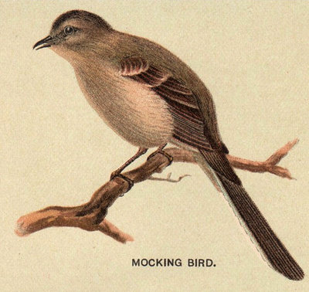
A PICTURE IS WORTH A THOUSAND WORDS
A complex idea can be conveyed with just a single still image, namely making it possible to absorb large amounts of data quickly.

Slide 8

Want big impact?
USE BIG IMAGE

Slide 9
USE CHARTS TO EXPLAIN YOUR IDEAS
White
Gray
Black

Slide 10
Ý NGHĨA
first
second
last

Slide 11
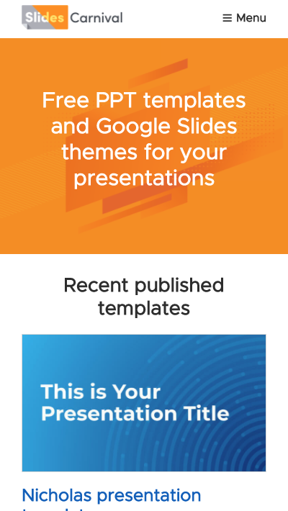
MOBILE PROJECT
Show and explain your web, app or software projects using these gadget templates.

Slide 12

TABLET PROJECT
Show and explain your web, app or software projects using these gadget templates.

Slide 13

DESKTOP PROJECT
Show and explain your web, app or software projects using these gadget templates.

Slide 14
THANKS!
Any questions?
You can find me at @username & user@mail.me

